Slide 1

QTM 151: Introduction to Statistical Computing II
Dr. Alejandro Sánchez Becerra

Slide 2
Agenda
Introductions
CLASS DETAILS
COMPUTING Environment
Installation

Slide 3
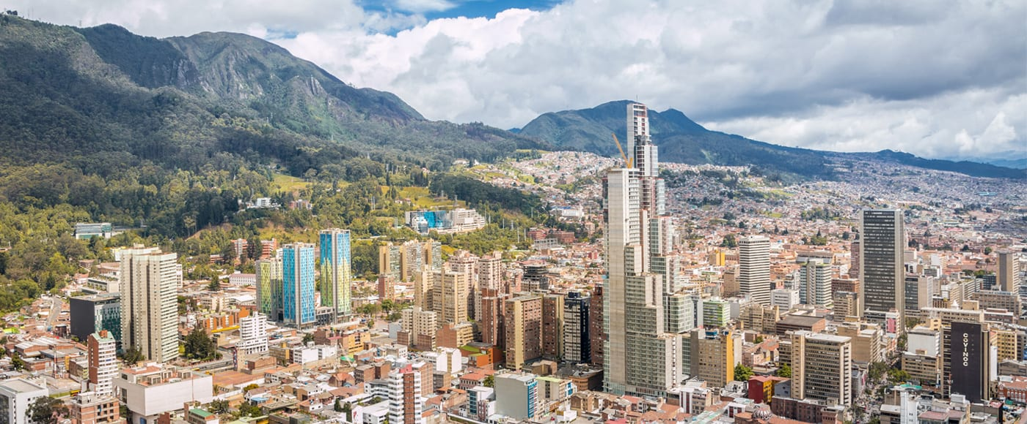
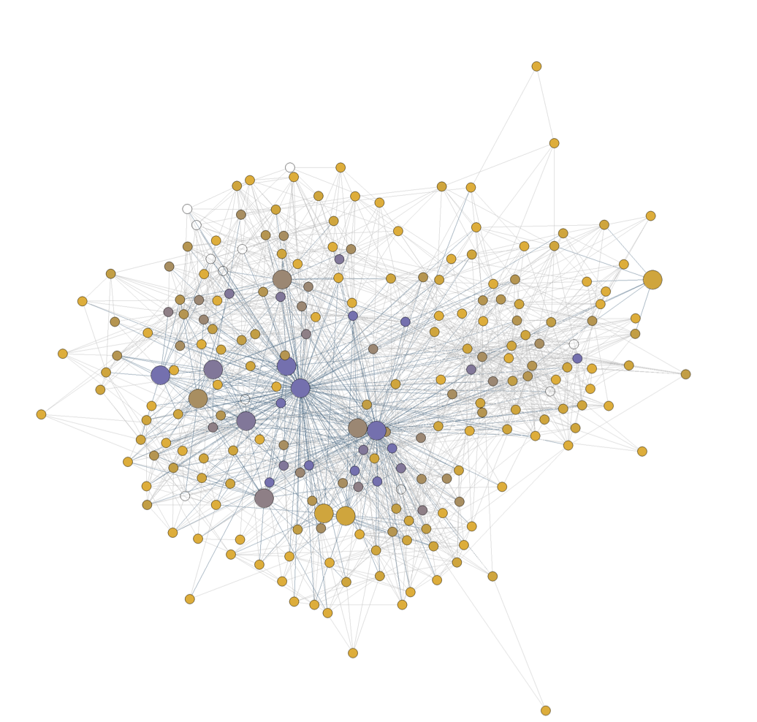
About me
My name is Alejandro Sánchez Becerra
First name: Alejandro
Two last names: Sánchez Becerra
I did my Ph.D. in Economics at the University of Pennsylvania and completed a post-doc at New York University.
I’m originally from Colombia
My research focuses on causal inference, machine learning, and network analysis. I focus on applications that evaluate poverty-reduction programs

Slide 4

My teaching philosophy
I like an interactive class where I engage with the students
Come to my office hours with questions so I can get to know you!
We will also constantly do “try it yourself” exercises.

Slide 5
Teaching Assistants
Nihal Khatwani
Molly Murphy
Sylvia Xing
They will be answering questions during our lectures and holding office hours (see Canvas for office hours information).

Slide 6
Agenda
Introductions
CLASS DETAILS
COMPUTING Environment
INSTALLATION

Slide 7



Two components:
Virtual Environment
+
Python
VS Code Interactive Development Environment (IDE)
(in background)
Programming language we use to write the instructions
The “frontend” software that you open every time you code something in Python
A “backend” software that you install once and hardly open again.

Slide 8

We open script files in VSCode
VS Code Interactive Development Environment (IDE)
Environment where the user writes the scripts
Script File
File with code in the Python programming language.
Instructions for the program to follow

Slide 9


Lecture Notes
VS Code
Github:
A file management system in the cloud (with desktop app)
Has version control
Great for collaborative programming

Slide 10

Towards the end of the class we’ll also introduce SQL. - Advanced database language - Widely used in industry. - Can be connected to Python and uses very similar ideas. More details to come!
+
VS Code

Slide 11
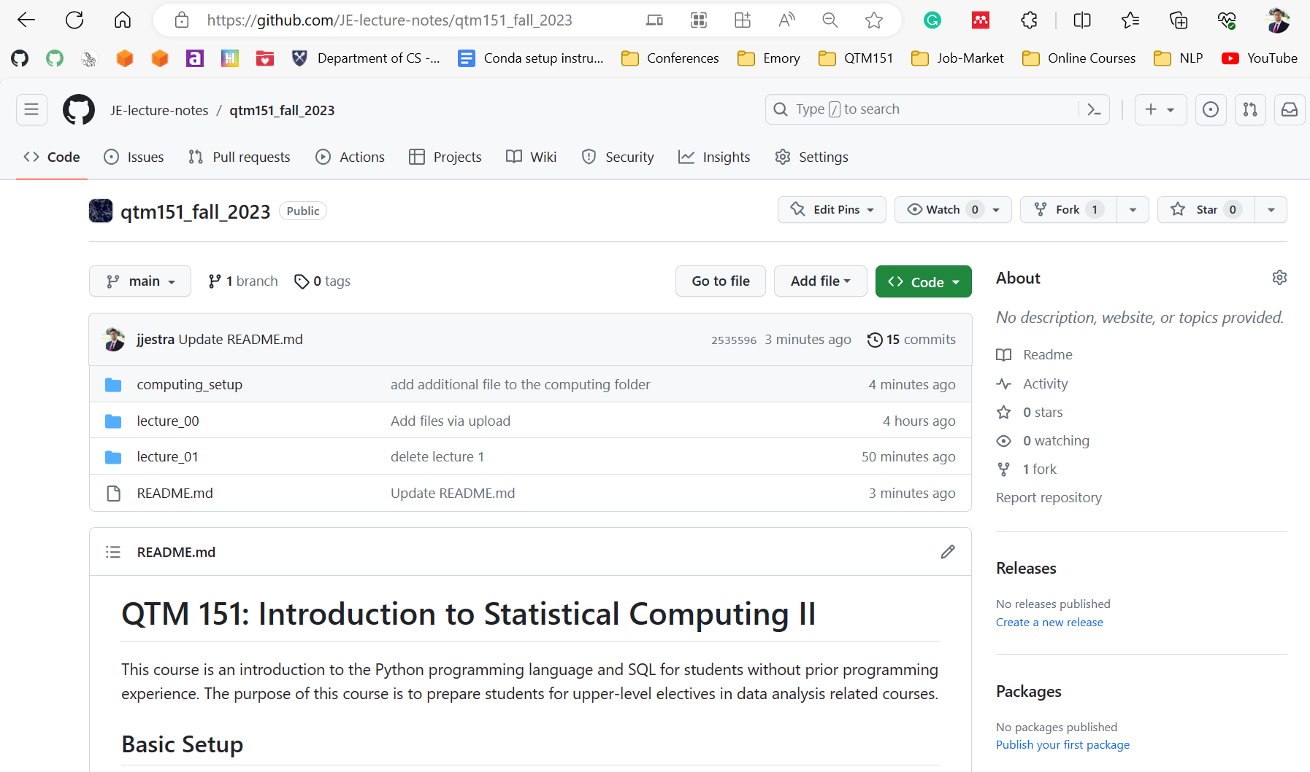
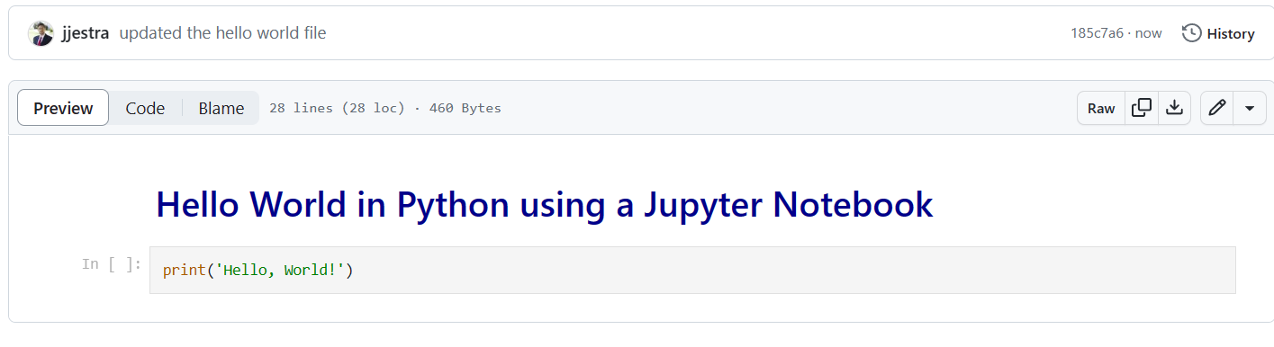
Lecture notes are publicly available at my GitHub website (link posted on Canvas):
https://github.com/alejandrosanchezbecerra/qtm151spring2025
You can view the lectures in the browser

Slide 12
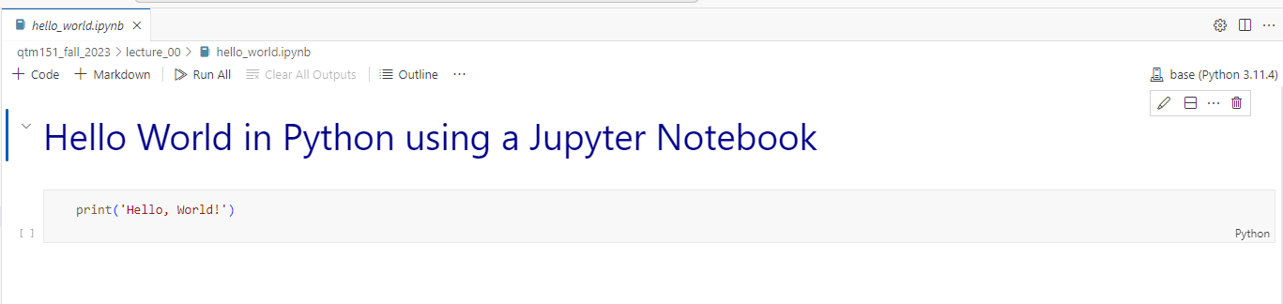
A Jupyter Notebook (“.ipynb”) is a file with code (python) and annotations (markdown)
All the lecture notes are written as Jupyter notebooks
It is encouraged that you bring your laptop to class
Lecture notes are designed to be follow-along. There will be “try it yourself” exercises.

Slide 13
VS Code
See Assignment 1
Basics of a Jupyter notebook
Need to have all the tools installed
Install soon that we can help you with any issues!

Slide 14

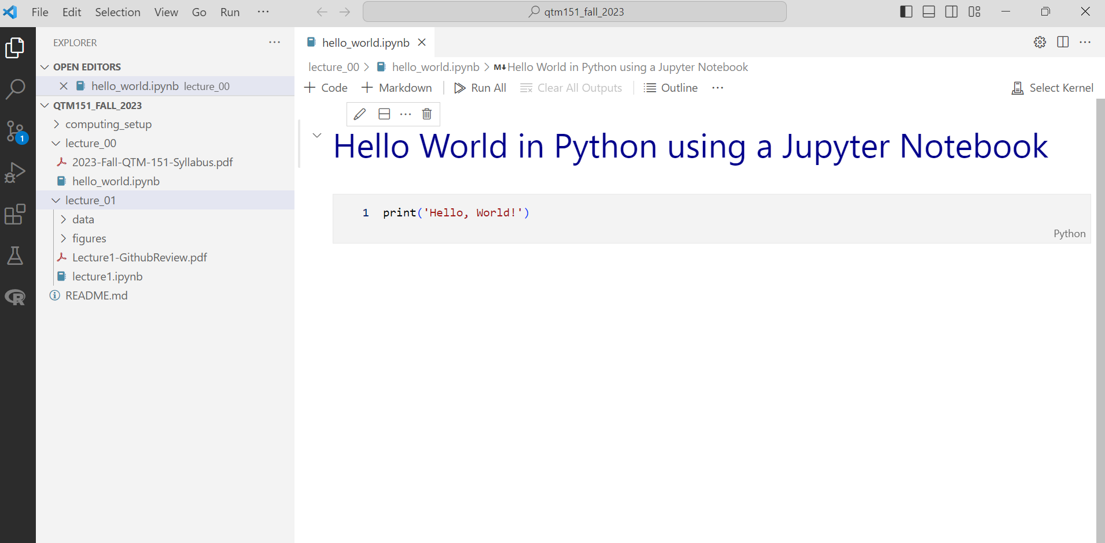
We will do all our coding in Visual Studio Code
Python
“.ipynb”: Interactive Python Notebook
Lecture notes

Slide 15
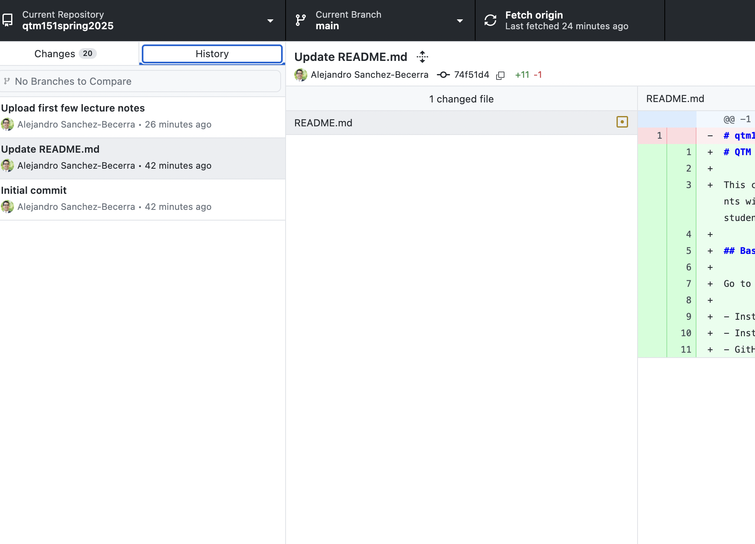
Github Desktop will allow you to automatically download the lectures notes from my account (and update them).
It will also show you
the date of any update
what the changes are
Update the lecture notes before class!

Slide 16
Questions about computing environment?

Slide 17
Agenda
Introductions
CLASS DETAILS
COMPUTING Environment
INSTALLATION

Slide 18
Learning Objectives
Learn how to code effectively in Python and SQL
Learn about key programming principles
Learn how to manipulate and visualize data

Slide 19
Grades
Late submissions
Late assignments will automatically be graded for half-credit
To account for unforeseen circumstances, we will drop the worst assignment and the worst quiz
Watch out for the assignments to install software. You will need these to be able to use the lectures notes.
Assignments (x 10): 50%
Practice class concepts
Quizzes (x5): 30%
Questions are given in advance
Data is provided in the class
Final Project: 20 %
Will provide guidelines on Canvas
Due at the end of the semester
Midsemester Survey: + 0.5% (Extra)
Final Course Evaluations: + 0.5% (Extra)

Slide 20
Coding ability is not innate
Coding ability can be developed.
Academic skills and abilities are acquired through hard work, mistakes, and perseverance.
My only goal here is that you learn the material. Please ask me questions!

Slide 21
Questions about the logistics

Slide 22
Agenda
Introductions
CLASS DETAILS
COMPUTING Environment
INSTALLATION

Slide 23
Let’s get started!
Open the documents in Canvas under “Installation” and follow instructions.
We will walk around to answer questions.
If you don’t complete the installation, we encourage you to visit one of the office hours, so that you are set up before the next class.

